Slide 1

Université de Mostaganem — Dr. Madani BELACEL
TD TIC 08 World Wide Web EN
Module TIC — Dr. BELACEL Madani
Université de Mostaganem — MCB

Slide 2
Université de Mostaganem — Dr. Madani BELACEL
🎯 Objectifs pédagogiques
• Comprendre les concepts clés
• Appliquer les compétences
• Évaluer les technologies

Slide 3
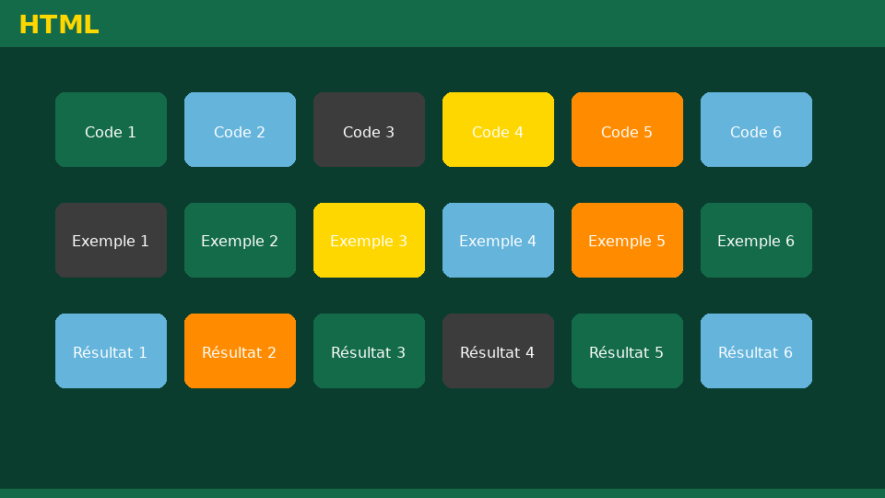
Université de Mostaganem — Dr. Madani BELACEL
📋 Plan du cours
• Exercise 1 — Parsing a URL
• Exercise 2 — Browsers
• Exercise 3 — HTTP vs HTTPS
• Exercise 4 — Academic research
• Exercise 5 — Web source evaluation

Slide 4
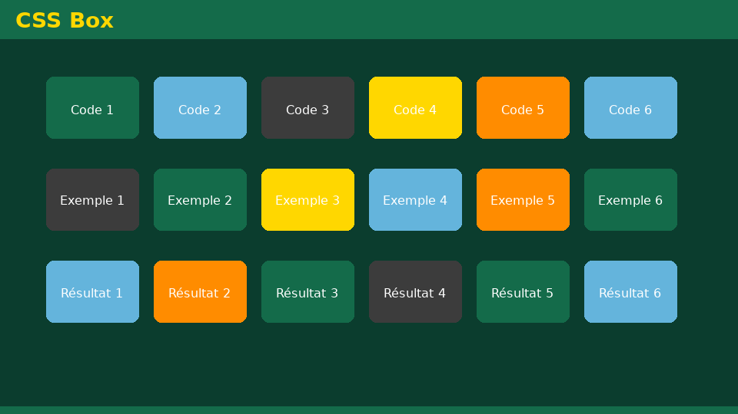
Exercise 1 — Parsing a URL
• Statement:Break down the URLhttps://www.univ-example.dz/cours/tic/chap2.html(protocol, domain, path).
• Detailed correction:-https://— secure HTTP protocol. -www.univ-example.dz— domain name (server). -/cours/tic/chap2.html— path to the resource (HTML page).
Université de Mostaganem — Dr. Madani BELACEL

Slide 5

Exercise 2 — Browsers
• Statement:Comparing two browsers (Chrome and Firefox): an advantage and an educational use for each.
• Detailed correction:- Chrome: numerous extensions; synchronization Google account. - Firefox: enhanced privacy; open source development. - Use: documentary research, Moodle access, online PDF reading.
Université de Mostaganem — Dr. Madani BELACEL

Slide 6

Exercise 3 — HTTP vs HTTPS
• Statement:Why choose HTTPS to connect to the university platform?
• Detailed correction:- Encryption of exchanged data (identifiers, notes). - Server authentication (SSL/TLS certificate). - Protection against eavesdropping on public network (Wi-Fi).
Université de Mostaganem — Dr. Madani BELACEL

Slide 7

Exercise 4 — Academic research
• Statement:Formulate an advanced query to find articles on “ICT and language teaching” (quotes, operators).
• Detailed correction:-"ICT" AND "language teaching"(Google academic or institutional engine). - Filter by date (last 5 years). - Favor.edudomains, university bibliographic bases. - Note author, title, URL, date of consultation for citation.
Université de Mostaganem — Dr. Madani BELACEL

Slide 8

Exercise 5 — Web source evaluation
• Statement:Evaluate the reliability of an anonymous blog vs. a.edupage: 4 criteria.
• Detailed correction:1.Authoridentified and qualified? 2.Dateof recent publication? 3.Objectivityand bibliographic references? 4.Institutional or commercial domain? → The anonymous blog should be discarded for a university assignment without overlap.
Université de Mostaganem — Dr. Madani BELACEL

Slide 9

• Statement:Break down the URLhttps://www.univ-example.dz/cours/tic/chap2.html(protocol, domain, path).
• Statement:Comparing two browsers (Chrome and Firefox): an advantage and an educational use for each.
• Statement:Why choose HTTPS to connect to the university platform?
📝 Points clés à retenir
Université de Mostaganem — Dr. Madani BELACEL

Slide 10
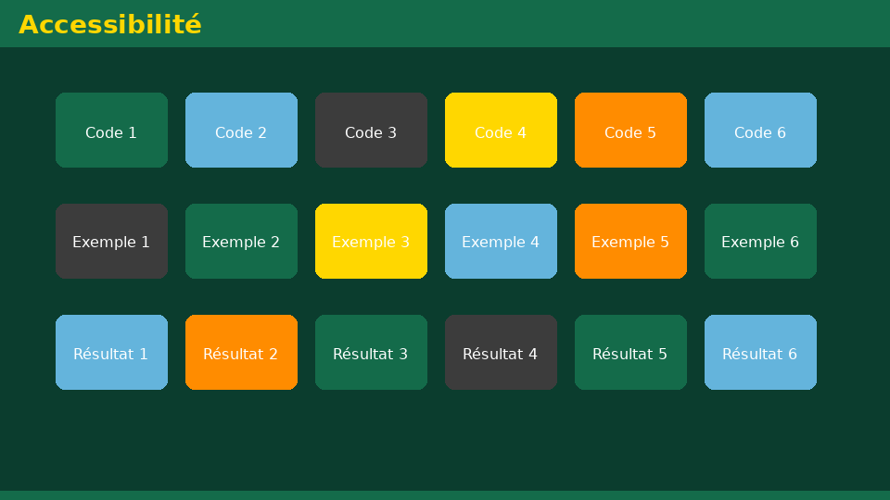
• Statement:Break down the URLhttps://www.univ-example.dz/cours/tic/chap2.html(protocol, domain, path).
• Statement:Comparing two browsers (Chrome and Firefox): an advantage and an educational use for each.
• Statement:Why choose HTTPS to connect to the university platform?
📝 Points clés à retenir
Université de Mostaganem — Dr. Madani BELACEL

Slide 11

• Statement:Break down the URLhttps://www.univ-example.dz/cours/tic/chap2.html(protocol, domain, path).
• Statement:Comparing two browsers (Chrome and Firefox): an advantage and an educational use for each.
• Statement:Why choose HTTPS to connect to the university platform?
📝 Points clés à retenir
Université de Mostaganem — Dr. Madani BELACEL

Slide 12

• Statement:Break down the URLhttps://www.univ-example.dz/cours/tic/chap2.html(protocol, domain, path).
• Statement:Comparing two browsers (Chrome and Firefox): an advantage and an educational use for each.
• Statement:Why choose HTTPS to connect to the university platform?
📝 Points clés à retenir
Université de Mostaganem — Dr. Madani BELACEL

Slide 13

Université de Mostaganem — Dr. Madani BELACEL
📝 Points clés à retenir
• Statement:Break down the URLhttps://www.univ-example.dz/cours/tic/chap2.html(protocol, domain, path).
• Statement:Comparing two browsers (Chrome and Firefox): an advantage and an educational use for each.
• Statement:Why choose HTTPS to connect to the university platform?
• Statement:Formulate an advanced query to find articles on “ICT and language teaching” (quotes, operators).
• Statement:Evaluate the reliability of an anonymous blog vs. a.edupage: 4 criteria.

Slide 14
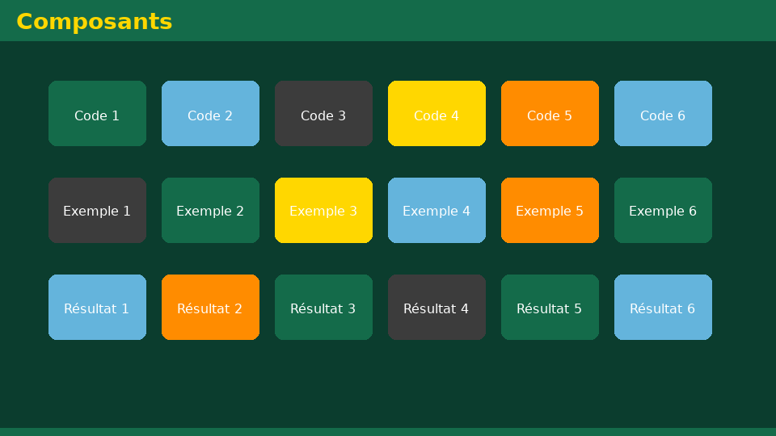
Université de Mostaganem — Dr. Madani BELACEL
✏️ Exercices d'application
• Définir les concepts principaux du cours
• Identifier les applications pratiques
• Résoudre les exercices du TD
• Synthétiser les points clés en un paragraphe
• Préparer une courte présentation orale

Slide 15
Université de Mostaganem — Dr. Madani BELACEL
🎓 Conclusion
Dr. BELACEL Madani Maître de Conférences B Université de Mostaganem madani.belacel@univ-mosta.dz

